Slide 1
Chapter 2: Point-to-Point Connections
Instructor Materials
CCNA Routing and Switching
Connecting Networks v6.0
Notes:
Cisco Networking Academy Program
Connecting Networks v6.0
Chapter 2: Point-Point Connections

Slide 2
Instructor Materials – Chapter 2 Planning Guide
This PowerPoint deck is divided in two parts:
Instructor Planning Guide
Information to help you become familiar with the chapter
Teaching aids
Instructor Class Presentation
Optional slides that you can use in the classroom
Begins on slide # 11
Note: Remove the Planning Guide from this presentation before sharing with anyone.
Notes:
2

Slide 3
Chapter 2: Point-to-Point Connections
Connecting Networks 6.0 Planning Guide
Notes:
Cisco Networking Academy Program
Connecting Networks v6.0
Chapter 2: Point-to-Point Connections

Slide 4
Chapter 2: Activities
What activities are associated with this chapter?
Page # | Activity Type | Activity Name | Optional?
2.0.1.2 | Class Activity | PPP Persuasion | Optional
2.1.2.4 | Syntax Checker | Troubleshooting a Serial Interface | Recommended
2.1.2.5 | Packet Tracer | Troubleshooting Serial Interfaces | Recommended
2.2.2.5 | Interactive Activity | Identify PPP Features and Operations | Recommended
2.2.3.5 | Interactive Activity | Identify the Steps in the LCP Link Negotiation | Recommended
2.3.1.4 | Syntax Checker | PPP Link Quality Monitoring Command | Recommended
2.3.2.5 | Syntax Checker | PPP Authentication Configuration | Recommended
2.3.2.5 | Syntax Checker | CHAP Authentication Configuration | Recommended
2.3.2.6 | Packet Tracer | Configuring PAP and CHAP Authentication | Recommended
Notes:
4

Slide 5
Chapter 2: Activities
What activities are associated with this chapter?
Page # | Activity Type | Activity Name | Optional?
2.3.2.7 | Lab | Configuring Basic PPP with Authentication | Recommended
2.4.1.4 | Packet Tracer | Troubleshooting PPP with Authentication | Recommended
2.4.1.5 | Lab | Troubleshooting Basic PPP with Authentication | Optional
2.5.1.1 | Class Activity | PPP Validation | Optional
2.5.1.2 | Packet Tracer | Skills Integration Challenge | Recommended
Notes:
5

Slide 6
Chapter 2: Assessment
Students should complete Chapter 2, “Assessment” after completing Chapter 2.
Quizzes, labs, Packet Tracers and other activities can be used to informally assess student progress.
Notes:
6

Slide 7
Chapter 2: Best Practices
Prior to teaching Chapter 2, the instructor should:
Complete Chapter 2, “Assessment.”
The objectives of this chapter are as follows:
Explain the fundamentals of point-to-point serial communication across a WAN.
Configure HDLC encapsulation on a point-to-point serial link.
Compare PPP and HDLC.
Explain the PPP-layered architecture and the functions of LCP and NCP.
Explain how PPP establishes a session.
Configure PPP encapsulation on a point-to-point serial link.
Configure PPP authentication.
Troubleshoot PPP using show and debug commands.
Notes:
7

Slide 8
Chapter 2: Best Practices (Cont.)
Compare and contrast HDLC and PPP.
Compare and contrast PAP and CHAP.
Use a WAN topology that has been addressed and investigate the default HDLC encapsulation verses PPP encapsulation.
Demonstrate the debug command with a topology that has issues with authentication or encapsulation.
Use the Skills Integration Challenge topology throughout the chapter for demonstration purposes.
Notes:
8

Slide 9
Chapter 2: Additional Help
For additional help with teaching strategies, including lesson plans, analogies for difficult concepts, and discussion topics, visit the CCNA Community at: https://www.netacad.com/group/communities/community-home
Best practices from around the world for teaching CCNA Routing and Switching. https://www.netacad.com/group/communities/ccna
If you have lesson plans or resources that you would like to share, upload them to the CCNA Community in order to help other instructors.
Students can enroll in Introduction to Packet Tracer (self-paced).
Notes:
9

Slide 11
Chapter 2: Point-to-Point Connections
CCNA Routing and Switching
Connecting Networks v6.0
Notes:
Cisco Networking Academy Program
Connecting Networks v6.0
Chapter 2: Point-to-Point Connections

Slide 12
Chapter 2 - Sections & Objectives
2.1 Serial Point-to-Point Overview
Configure HDLC encapsulation.
Explain the fundamentals of point-to-point serial communication across a WAN.
Configure HDLC encapsulation on a point-to-point serial link.
2.2 PPP Operation
Explain how PPP operates across a point-to-point serial link.
Compare PPP and HDLC.
Explain the PPP-layered architecture and the functions of LCP and NCP.
Explain how PPP establishes a session.
Notes:
12
Cisco Networking Academy Program
Connecting Networks v6.0
Chapter 2: Point-to-Point Connections

Slide 13
Chapter 2 - Sections & Objectives (Cont.)
2.3 PPP Implementation
Configure PPP encapsulation.
Configure PPP encapsulation on a point-to-point serial link.
Configure PPP authentication.
2.4 Troubleshoot WAN Connectivity
Troubleshoot PPP.
Troubleshoot PPP using show and debug commands.
Notes:
13
Cisco Networking Academy Program
Connecting Networks v6.0
Chapter 2: Point-to-Point Connections

Slide 14
2.1 Serial Point-to-Point Overview
Notes:
2 - Point-to-Point Connections
2.1 – Serial Point-to-Point Overview

Slide 15
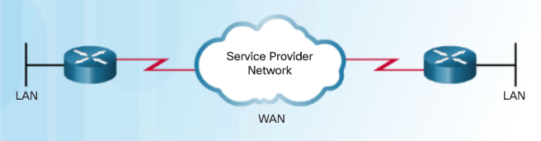
Serial Communications Serial and Parallel Ports
A WAN is owned by a service provider and a LAN is typically owned by an organization.
Point-to-point connections connect LANs to service provider WANs and connect LAN segments.
A LAN-to-WAN point-to-point connection is also referred to as a serial connection or leased-line connection.
Lines are leased from a carrier.
Companies pay for a continuous connection between two remote sites, and the line is continuously active and available.
Serial Point-to-Point Connection
Notes:
2.1 – Serial Point-to-Point Overview
2.1.1 – Serial Communications
2.1.1.1 – Serial and Parallel Ports

Slide 16
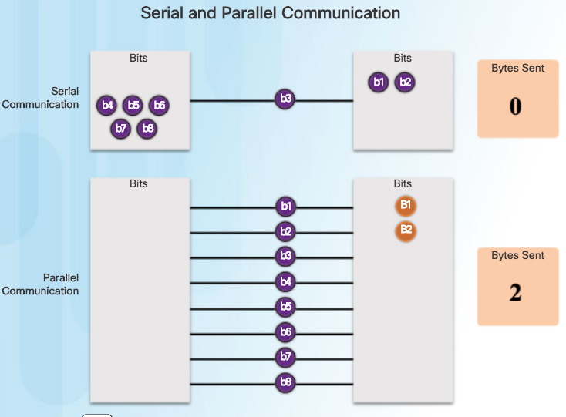
Serial Communications Serial and Parallel Ports (Cont.)
Serial Communication
Method of data transmissions in which the bits are transmitted sequentially over a single channel.
Equivalent to a pipe only wide enough to fit one ball at a time. Multiple balls can go into the pipe, but only one at a time, and they only have one exit point, the other end of the pipe.
Parallel communications
Bits can be transmitted simultaneously over multiple wires.
Sends a byte (eight bits) in the time that a serial connection sends a single bit.
At one time, most PCs included both serial and parallel ports. Parallel ports were used to connect printers, computers, and other devices that required relatively high bandwidth.
On most PCs, parallel ports and RS-232 serial ports have been replaced by the higher speed serial Universal Serial Bus (USB) interfaces.
Notes:
2.1 – Serial Point-to-Point Overview
2.1.1 – Serial Communications
2.1.1.1 – Serial and Parallel Ports

Slide 17
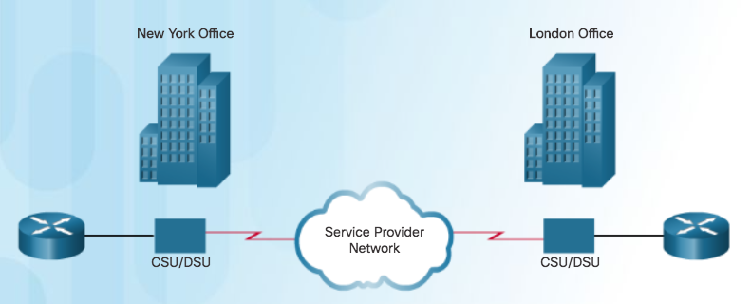
Serial Communications Point-to-Point Communication Links
Point-to-point link
Used when permanent dedicated connections are required
Provides a single, pre-established WAN communications path
Path goes from the customer premises, through the provider network, to a remote destination, as shown in the figure
Can connect two geographically distant sites, such as a corporate office in New York and a regional office in London
Not limited to connections that cross land (undersea fiber-optics)
Usually more expensive than shared services
Constant availability is essential for some applications such as VoIP or video over IP.
Notes:
2.1 – Serial Point-to-Point Overview
2.1.1 – Serial Communications
2.1.1.2 – Point-to-Point Communication Links

Slide 18
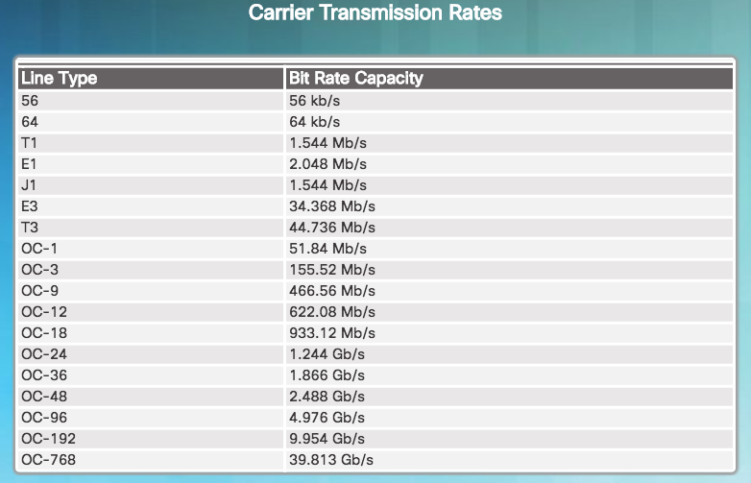
Serial Communications Serial Bandwidth
Bandwidth
Refers to the rate at which data is transferred over the communication link.
Carrier technology will dictate how much bandwidth is available.
North American (T-carrier) specification
European (E-carrier) system
U.S. Optical Carrier (OC) bandwidth points
OC transmission rates are a set of standardized specifications for the transmission of digital signals carried on SONET fiber-optic networks.
In North America, expressed as a digital signal level number (DS0, DS1, etc.), which refers to the rate and format of the signal.
Most fundamental line speed is 64 kb/s, or DS0.
24 DS0s can be bundled to get a DS1 line (T1 line).
28 DS1s can be bundled to get a DS3 line (T3 line).
Notes:
2.1 – Serial Point-to-Point Overview
2.1.1 – Serial Communications
2.1.1.3 – Serial Bandwidth

Slide 19
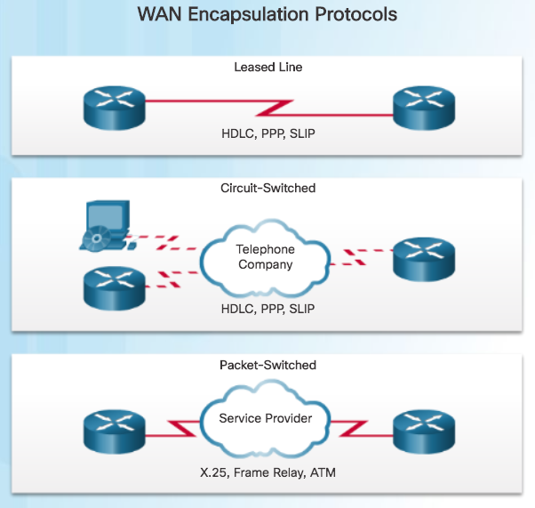
HDLC Encapsulation WAN Encapsulation Protocols
Data is encapsulated into frames before crossing the WAN link and must be configured for the appropriate Layer 2 protocol.
Choice of protocol depends on the WAN technology and the communicating equipment.
WAN protocols (HDLC and PPP are the focus of this course):
HDLC - Default encapsulation on point-to-point connections, dedicated links, and circuit-switched connections when the link uses two Cisco devices.
PPP - Provides router-to-router and host-to-network connections over synchronous and asynchronous circuits. Has built-in security mechanisms such as PAP and CHAP.
Serial Line Internet Protocol (SLIP) - Displaced by PPP.
X.25/Link Access Procedure, Balanced (LAPB) - Predecessor to Frame Relay.
Frame Relay - Data link layer protocol that handles multiple virtual circuits. After X.25.
ATM - International standard for cell relay in which devices send multiple service types, such as voice, video, or data, in fixed-length (53-byte) cells. Takes advantage of high-speed transmission media such as E3, SONET, and T3..
Notes:
2.1 – Serial Point-to-Point Overview
2.1.2 – HDLC Encapsulation
2.1.2.1 – WAN Encapsulation Protocols

Slide 20
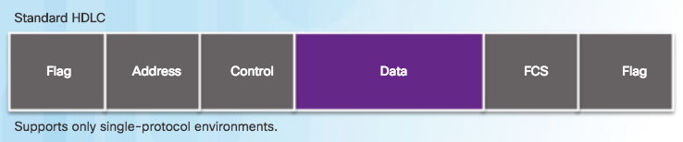
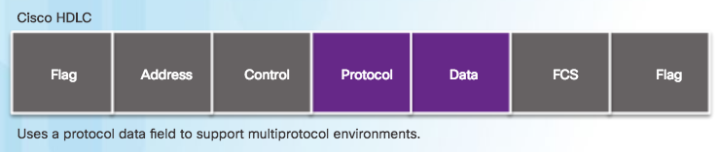
HDLC Encapsulation HDLC Encapsulation
HDLC is a synchronous data link layer protocol developed by the International Organization for Standardization (ISO).
HDLC defines a Layer 2 framing structure that allows flow and error control through acknowledgments.
Default serial encapsulation method when connecting two Cisco routers.
Cisco’s HDLC is a point-to-point protocol that can be used on leased lines between two Cisco devices.
Protocol field makes it possible for a single serial link to accommodate multiple network-layer protocols.
The figure compares standard HDLC to Cisco HDLC.
Uses a frame delimiter, or flag, to mark beginning and end of each frame.
With an added protocol type field, Cisco HDLC can only work with other Cisco devices.
Notes:
2.1 – Serial Point-to-Point Overview
2.1.2 – HDLC Encapsulation
2.1.2.2 – HDLC Encapsulation

Slide 21
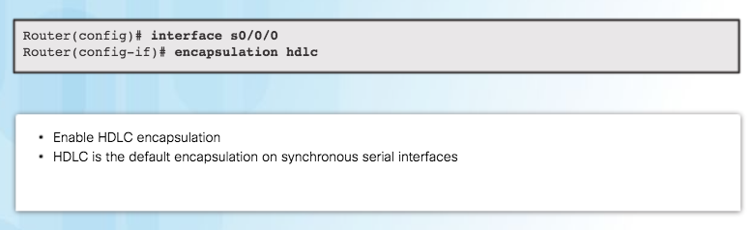
HDLC Encapsulation Configuring HDLC Encapsulation
Use Cisco HDLC as a point-to-point protocol on leased lines between two Cisco devices.
If connecting non-Cisco devices, use synchronous PPP.
If the default encapsulation method has been changed, use the encapsulation hdlc command in interface configuration mode to re-enable HDLC.
Notes:
2.1 – Serial Point-to-Point Overview
2.1.2 – HDLC Encapsulation
2.1.2.3 – Configuring HDLC Encapsulation

Slide 22
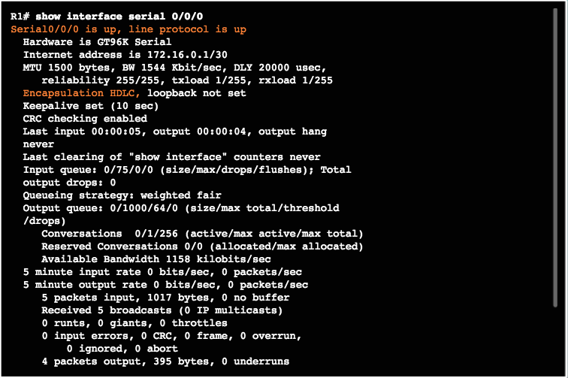
HDLC Encapsulation Troubleshooting a Serial Interface
The show interfaces serial x/x/x command displays information specific to serial interfaces.
When HDLC is configured, “encapsulation HDLC” should be reflected in the output as highlighted in the figure.
“Serial 0/0/0 is up, line protocol is up”, indicates that the line is up and functioning.
Notes:
2.1 – Serial Point-to-Point Overview
2.1.2 – HDLC Encapsulation
2.1.2.4 – Troubleshooting a Serial Interface

Slide 23
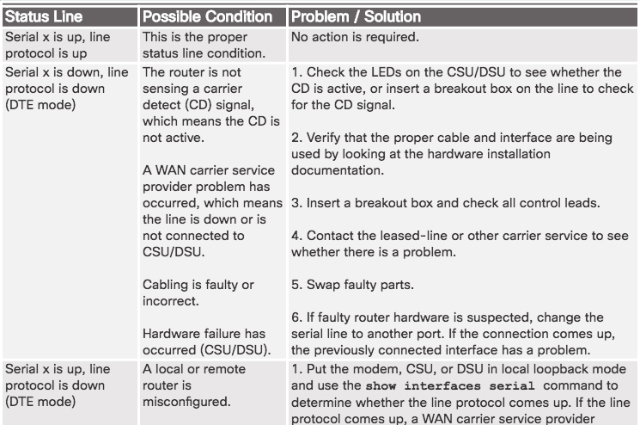
HDLC Encapsulation Troubleshooting a Serial Interface (Cont.)
Serial interface issues associated with state, and how to troubleshoot the issue.
Notes:
2.1 – Serial Point-to-Point Overview
2.1.2 – HDLC Encapsulation
2.1.2.4 – Troubleshooting a Serial Interface

Slide 24
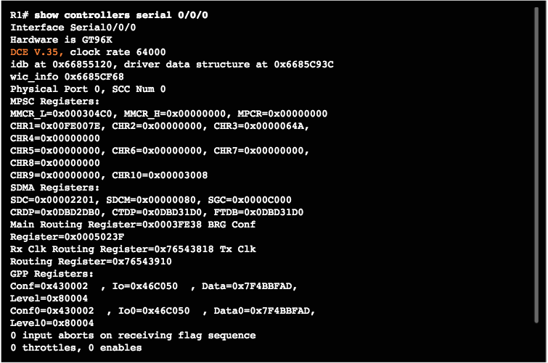
HDLC Encapsulation Troubleshooting a Serial Interface (Cont.)
Show controllers command output indicates the state of the interface channels and whether a cable is attached to the interface. In the figure, interface serial 0/0/0 has a V.35 DCE cable attached.
Notes:
2.1 – Serial Point-to-Point Overview
2.1.2 – HDLC Encapsulation
2.1.2.4 – Troubleshooting a Serial Interface

Slide 25
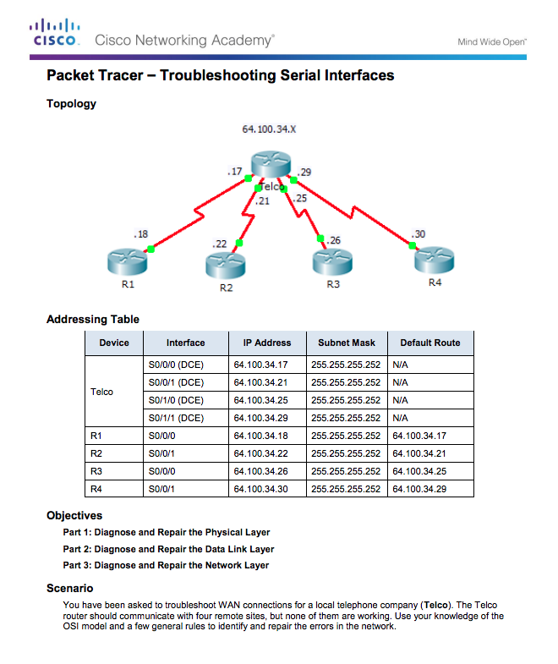
HDLC Encapsulation Packet Tracer - Troubleshooting Serial Interfaces
Notes:
2.1 – Serial Point-to-Point Overview
2.1.2 – HDLC Encapsulation
2.1.2.5 – Packet Tracer – Troubleshooting Serial Interfaces

Slide 26
2.2 PPP Operation
Notes:
2 - Point-to-Point Connections
2.2 – PPP Operation

Slide 27
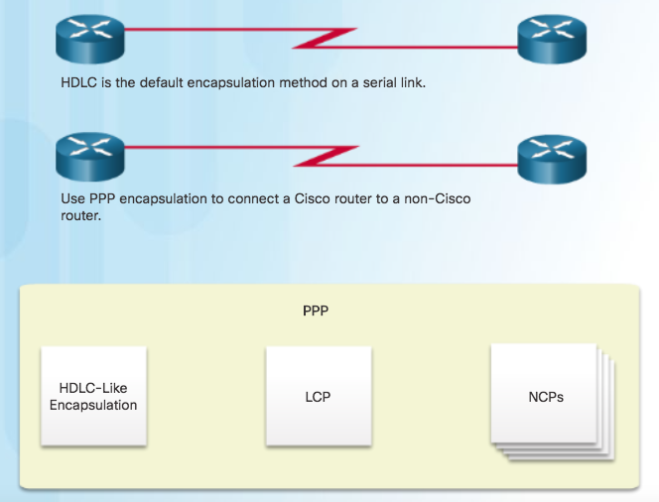
Benefits of PPP Introducing PPP
PPP encapsulation should be used when there is a need to connect to a non-Cisco router.
PPP encapsulates data frames for transmission over Layer 2 physical links.
PPP establishes a direct connection using serial cables, phone lines, trunk lines, cellular telephones, specialized radio links, or fiber-optic links.
PPP contains three main components:
HDLC-like framing for transporting multiprotocol packets over point-to-point links.
Extensible Link Control Protocol (LCP) for establishing, configuring, and testing the data-link connection.
Network Control Protocols (NCPs) for establishing and configuring different network layer protocols (IPv4 and IPv6 Control Protocol).
What is PPP?
Notes:
2.2 – PPP Operation
2.2.1 – Benefits of PPP
2.2.1.1 – Introducing PPP

Slide 28
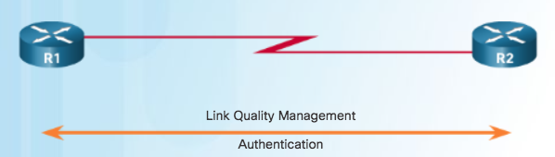
Benefits of PPP Advantages of PPP
PPP includes many features not available in HDLC:
The link quality management feature (LQM) monitors the quality of the link. LQM can be configured with the interface command ppp quality percentage. If the error percentage falls below the configured threshold, the link is taken down and packets are rerouted or dropped.
PPP supports PAP and CHAP authentication.
Notes:
2.2 – PPP Operation
2.2.1 – Benefits of PPP
2.2.1.2 – Advantages of PPP

Slide 29
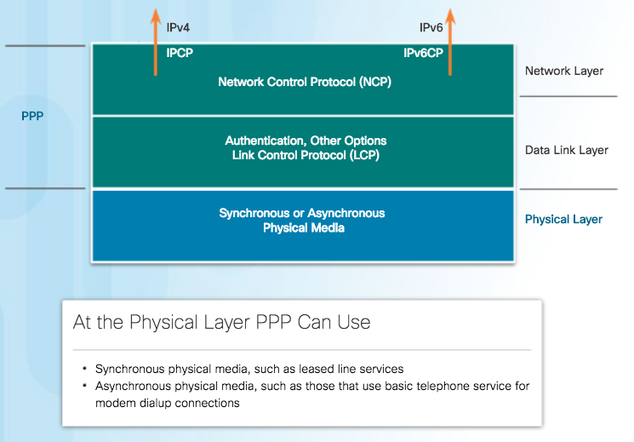
LCP and NCP PPP Layered Architecture
The figure maps the layered architecture of PPP against the Open System Interconnection (OSI) model.
PPP and OSI share the same physical layer, but PPP distributes the functions of LCP and NCP differently.
PPP requires a full-duplex circuit, either dedicated or switched, that can operate in an asynchronous or synchronous bit-serial mode.
Most of the work done by PPP happens at the data link and network layers, by LCP and NCPs.
Notes:
2.2 – PPP Operation
2.2.2 – LCP and NCP
2.2.2.1 – PPP Layered Architecture

Slide 30
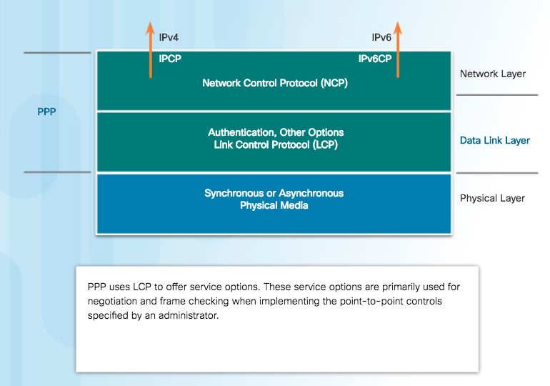
LCP and NCP PPP – Link Control Protocol (LCP)
LCP functions within the data link layer and has a role in establishing, configuring, and testing the data-link connection.
LCP establishes the point-to-point link.
LCP also negotiates and sets up control options on the WAN data link, which are handled by the NCPs.
After the link is established, PPP also uses LCP to agree automatically on encapsulation formats such as authentication, compression, and error detection.
Notes:
2.2 – PPP Operation
2.2.2 – LCP and NCP
2.2.2.2 – PPP – Link Control Protocol (LCP)

Slide 31
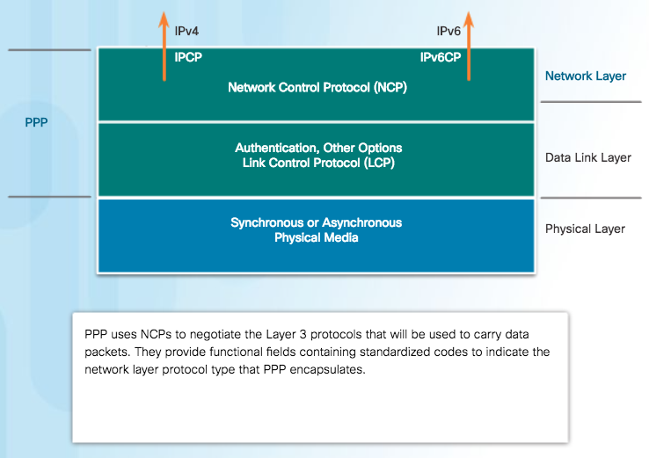
LCP and NCP PPP – Network Control Protocol (NCP)
PPP permits multiple network layer protocols to operate on the same communications link.
For every network layer protocol used, PPP uses a separate NCP, as shown in the figure. IPv4 uses IP Control Protocol and IPv6 uses IPv6 Control Protocol.
NCPs include functional fields containing standardized codes to indicate the network layer protocol that PPP encapsulates.
Value 8021 = IPCP
Value 8057 = IPv6CP
Notes:
2.2 – PPP Operation
2.2.2 – LCP and NCP
2.2.2.3 – PPP – Network Control Protocol (NCP)

Slide 32
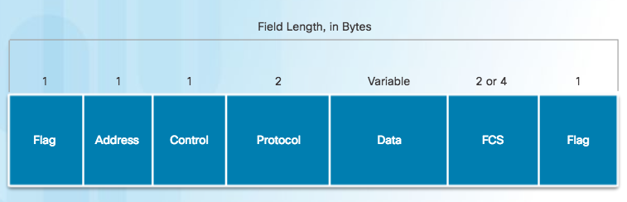
LCP and NCP PPP Frame Structure
PPP Frame Fields
Flag - A single byte that indicates the beginning or end of a frame. The Flag field consists of the binary sequence 01111110.
Address - A single byte that contains the binary sequence 11111111, the standard broadcast address
Control - A single byte that contains the binary sequence 00000011, which calls for transmission of user data in an unsequenced frame.
Protocol - Two bytes that identify the protocol encapsulated in the information field of the frame.
Data - Zero or more bytes that contain the datagram for the protocol specified in the protocol field.
Frame Check Sequence (FCS) – This is normally 16 bits (2 bytes). If the receiver’s calculation of the FCS does not match the FCS in the PPP frame, the PPP frame is silently discarded
Notes:
2.2 – PPP Operation
2.2.2 – LCP and NCP
2.2.2.4 – PPP Frame Structure

Slide 33
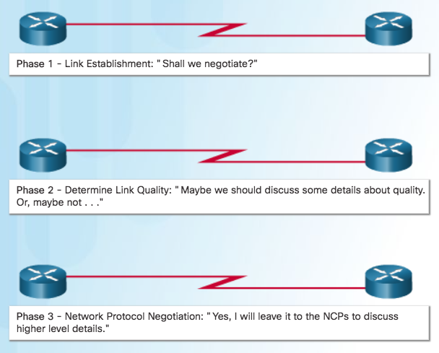
PPP Sessions Establishing a PPP Session
Phase 1: Link establishment and configuration negotiation - Before PPP exchanges any network layer datagrams, such as IP, the LCP must first open the connection and negotiate configuration options. This phase is complete when the receiving router sends a configuration-acknowledgment frame back to the router initiating the connection.
Phase 2: Link quality determination (optional) - The LCP tests the link to determine whether the link quality is sufficient to bring up network layer protocols.
Phase 3: Network layer protocol configuration negotiation - After the LCP has finished Phase 2, the appropriate NCP can separately configure the network layer protocols, and bring them up and take them down at any time. If the LCP closes the link, it informs the network layer protocols so that they can take appropriate action.
Notes:
2.2 – PPP Operation
2.2.3 – PPP Sessions
2.2.3.1 – Establishing a PPP Session

Slide 34
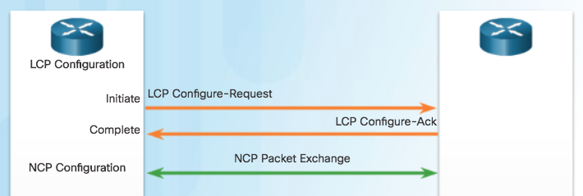
PPP Sessions LCP Operation
Link Establishment
LCP operation includes provisions for 3 classes of LCP frames:
Link-establishment frames
Link-maintenance frames
Link-termination frames
During link establishment, the LCP opens the connection and negotiates the configuration parameters. The link establishment process starts with the initiating device sending a Configure-Request frame to the responder.
Responder processes the request:
If the options are not acceptable or not recognized, the responder sends a Configure-Nak or Configure-Reject message.
If the options are acceptable, the responder responds with a Configure-Ack message and the process moves on to the authentication stage. The operation of the link is handed over to the NCP.
When NCP has completed all necessary configurations, including validating authentication, the line is available for data transfer. During the exchange of data, LCP transitions into link maintenance.
Notes:
2.2 – PPP Operation
2.2.3 – PPP Sessions
2.2.3.2 – LCP Operation

Slide 35
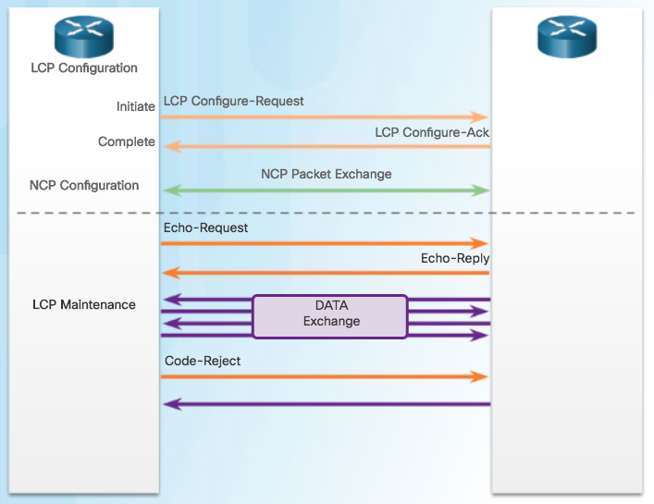
PPP Sessions LCP Operation (Cont.)
During link maintenance, LCP can use messages to provide feedback and test the link.
Echo-Request, Echo-Reply, and Discard-Request - These frames can be used for testing the link.
Code-Reject and Protocol-Reject - These frame types provide feedback when one device receives an invalid frame. The sending device will resend the packet.
Link Maintenance
Notes:
2.2 – PPP Operation
2.2.3 – PPP Sessions
2.2.3.2 – LCP Operation

Slide 36
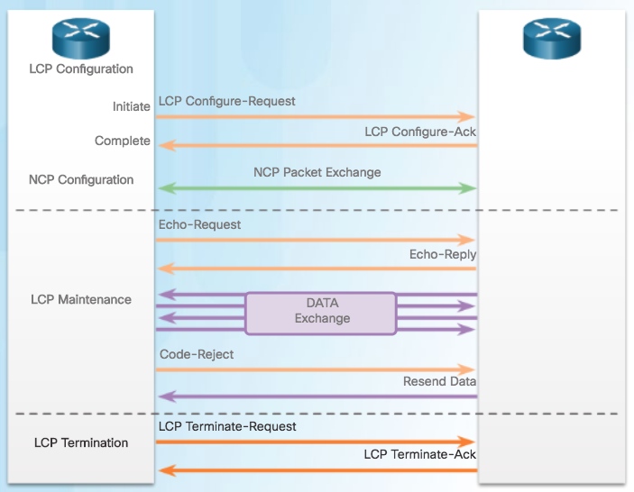
PPP Sessions LCP Operation (Cont.)
Link Termination
After the transfer of data at the network layer completes, the LCP terminates the link. NCP only terminates the network layer and NCP link. The link remains open until the LCP terminates it.
PPP can terminate the link at any time because of the loss of the carrier, authentication failure, link quality failure, the expiration of an idle-period timer, or the administrative closing of the link.
The LCP closes the link by exchanging Terminate packets.
Device initiating the shutdown sends a Terminate-Request message. Other device replies with a Terminate-Ack.
Notes:
2.2 – PPP Operation
2.2.3 – PPP Sessions
2.2.3.2 – LCP Operation

Slide 37
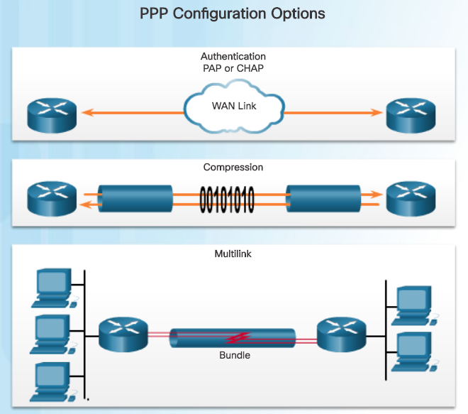
PPP Sessions PPP Configuration Options
Authentication using either PAP or CHAP
Compression using either Stacker or Predictor
Multilink that combines two or more channels to increase the WAN bandwidth
Notes:
2.2 – PPP Operation
2.2.3 – PPP Sessions
2.2.3.3 – PPP Configuration Options

Slide 38
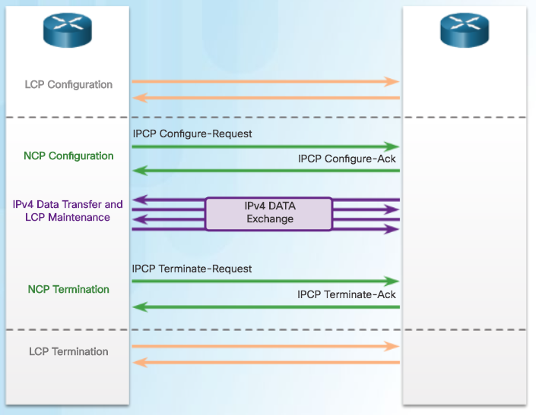
PPP Sessions NCP Explained
After LCP has established the link, the routers exchange IPCP messages, negotiating options specific to IPv4.
IPCP is responsible for configuring, enabling, and disabling the IPv4 modules on both ends of the link.
IPCP negotiates two options:
Compression - Allows devices to negotiate an algorithm to compress TCP and IP headers and save bandwidth.
IPv4-Address - Allows the initiating device to specify an IPv4 address to use for routing IP over the PPP link, or to request an IPv4 address for the responder.
After the NCP process is complete, the link goes into the open state and LCP takes over again in a link maintenance phase.
When data transfer is complete, NCP terminates the protocol link and LCP terminates the PPP connection.
Notes:
2.2 – PPP Operation
2.2.3 – PPP Sessions
2.2.3.4 – NCP Explained

Slide 39
2.3 PPP Implementation
Notes:
2 - Point-to-Point Connections
2.3 – PPP Implementation

Slide 40
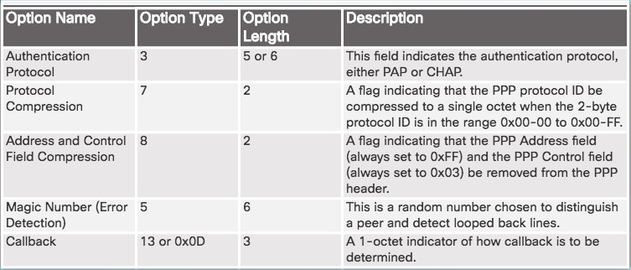
Configure PPP PPP Configuration Options
Compression - Two compression protocols available in Cisco routers are Stacker and Predictor.
Error detection - Identifies fault conditions. The Quality and Magic Number options help ensure a reliable, loop-free data link.
PPP Callback - PPP callback is used to enhance security. With this LCP option, a Cisco router can act as a callback client or a callback server.
Configurable Options Field Codes
Notes:
2.3 – PPP Implementation
2.3.1 – Configure PPP
2.3.1.1 – PPP Configuration Options

Slide 41
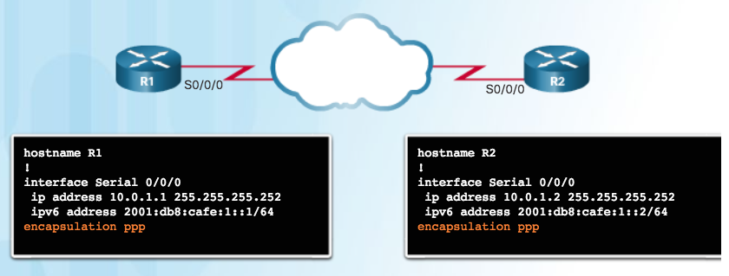
Configure PPP PPP Basic Configuration Command
Remember that if PPP is not configured on a Cisco router, the default encapsulation for serial interfaces is HDLC.
PPP is a Layer 2 encapsulation that supports various Layer 3 protocols including IPv4 and IPv6.
Notes:
2.3 – PPP Implementation
2.3.1 – Configure PPP
2.3.1.2 – PPP Basic Configuration Command

Slide 42
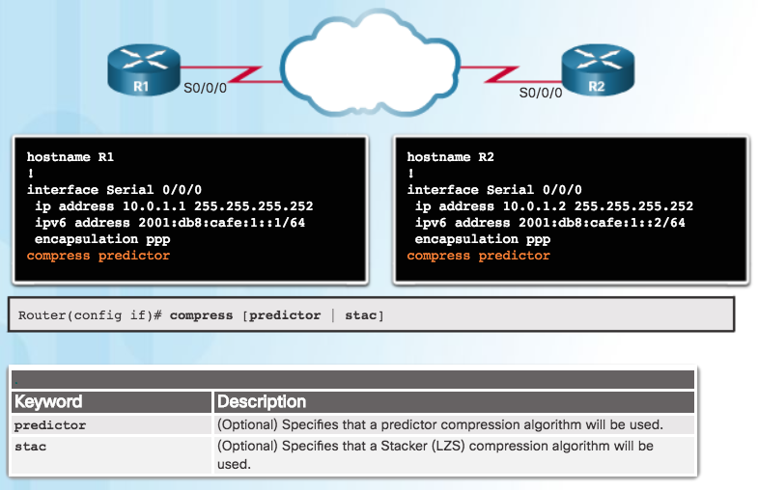
Configure PPP PPP Compression Commands
Point-to-point software compression on serial interfaces can be configured after PPP encapsulation is enabled.
Because this option invokes a software compression process, it can affect system performance.
Notes:
2.3 – PPP Implementation
2.3.1 – Configure PPP
2.3.1.3 – PPP Compression Commands

Slide 43
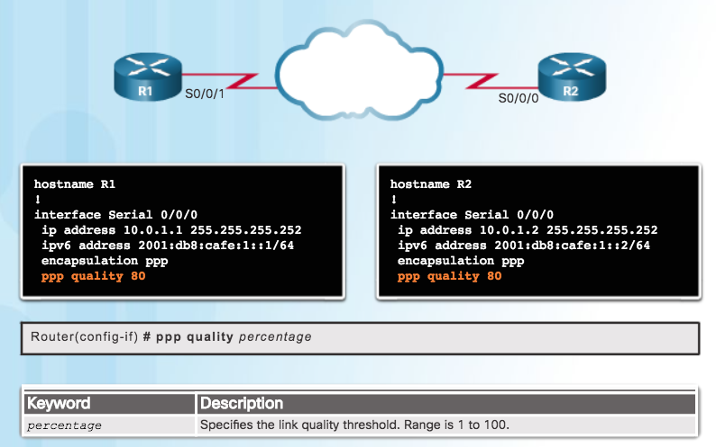
Configure PPP PPP Link Quality Monitoring Command
The ppp quality percentage command ensures that the link meets the set quality requirement; otherwise, the link closes down
Percentages are calculated for both incoming and outgoing directions
Configuration ppp quality 80, shown in the figure, sets minimum quality to 80%
Notes:
2.3 – PPP Implementation
2.3.1 – Configure PPP
2.3.1.4 – PPP Link Quality Monitoring Command

Slide 44
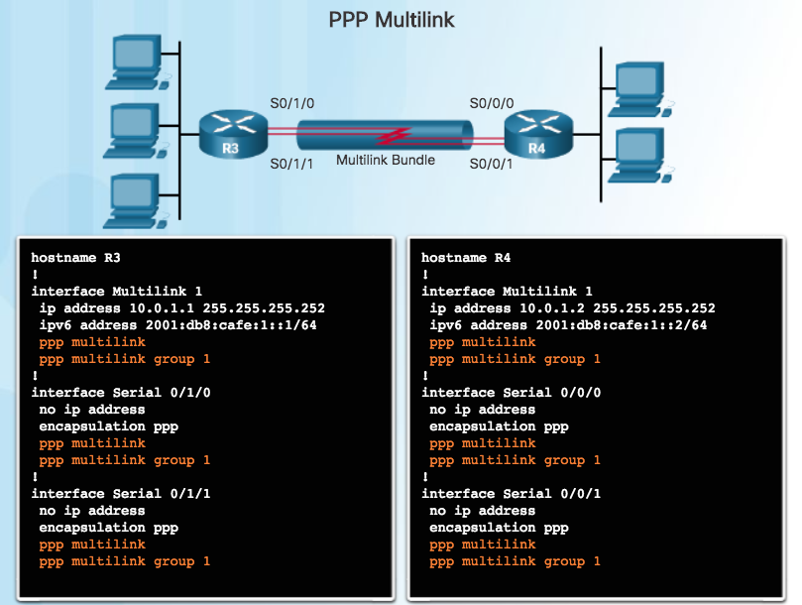
Configure PPP PPP Multilink Commands
Multilink PPP provides a method for spreading traffic across multiple physical WAN links.
Configuring MPPP requires two steps, as shown in the figure.
Step 1. Create a multilink bundle.
Step 2. Assign interfaces to the multilink bundle.
To disable PPP multilink, use the no ppp multilink command on each of the bundled interfaces.
Notes:
2.3 – PPP Implementation
2.3.1 – Configure PPP
2.3.1.5 – PPP Multilink Commands

Slide 45
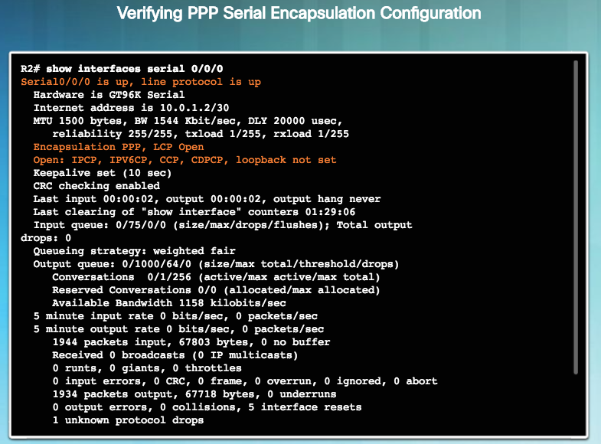
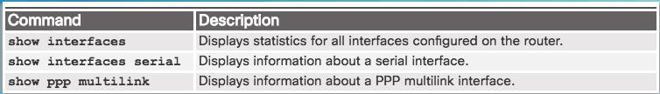
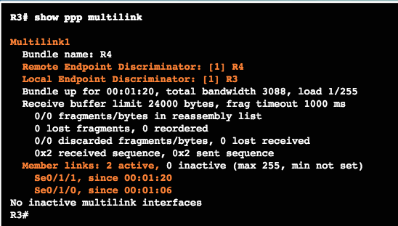
Configure PPP Verifying PPP Configuration
Notes:
2.3 – PPP Implementation
2.3.1 – Configure PPP
2.3.1.6 – Verifying PPP Configuration

Slide 46
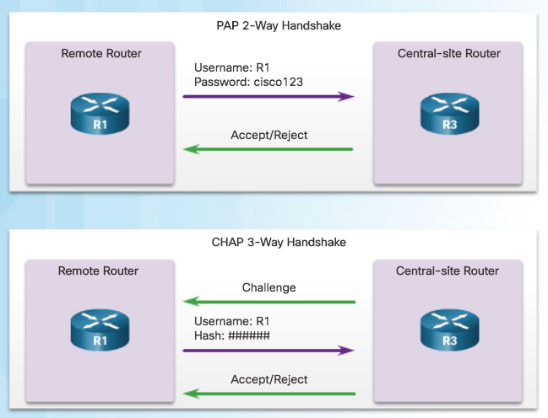
Configure PPP Authentication PPP Authentication Protocols
PAP is a very basic two-way process with no encryption. The username and password are sent in plaintext. If it is accepted, the connection is allowed.
CHAP is more secure than PAP. It involves a three-way exchange of a shared secret.
The authentication phase of a PPP session is optional. If used, the peer is authenticated after LCP establishes the link and chooses the authentication protocol.
Authentication takes place before the network layer protocol configuration phase begins.
Notes:
2.3 – PPP Implementation
2.3.2 – Configure PPP Authentication
2.3.2.1 – PPP Authentication Protocols

Slide 47
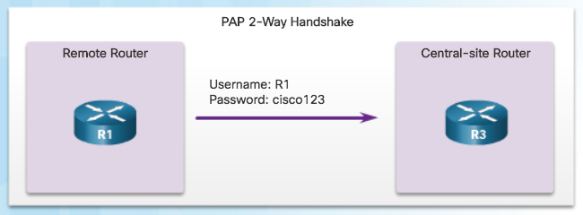
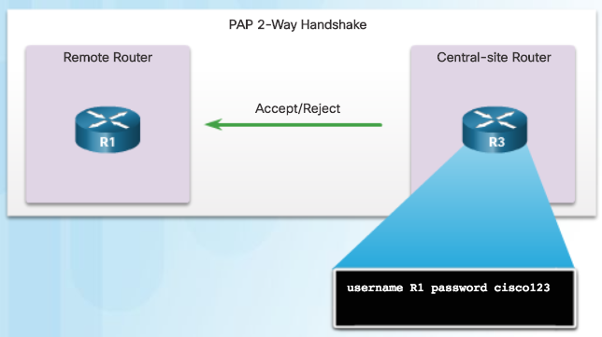
Configure PPP Authentication Password Authentication Protocol (PAP)
Initiating PAP – R1 Sends its PAP username and password to R3.
Note: PAP is not a strong authentication protocol. Using PAP, passwords are sent across the link in plaintext and there is no protection from playback or repeated trial-and-error attacks.
Completing PAP – R3 Evaluates R1’s username and password against its local database. If it matches, it accepts the connection. If not, it rejects the connection.
Notes:
2.3 – PPP Implementation
2.3.2 – Configure PPP Authentication
2.3.2.2 – Password Authentication Protocol (PAP)

Slide 48

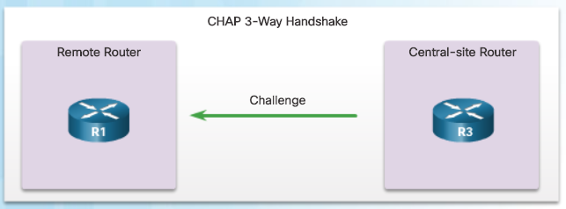
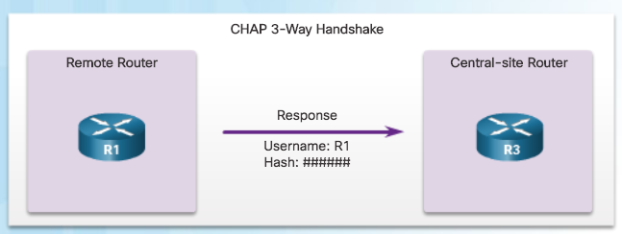
Configure PPP Authentication Challenge Handshake Authentication Protocol (CHAP)
#1 R3 initiates the 3-way handshake and sends a challenge message to R1.
#3 The local router checks the response against its own calculation of the expected hash value. If the values match, the initiating node acknowledges the authentication.
#2 The remote node responds with a value that is calculated using a one-way hash function.
Note: CHAP conducts periodic challenges to make sure that the remote node still has a valid password value.
Notes:
2.3 – PPP Implementation
2.3.2 – Configure PPP Authentication
2.3.2.3 – Challenge Handshake Authentication Protocol (CHAP)

Slide 49
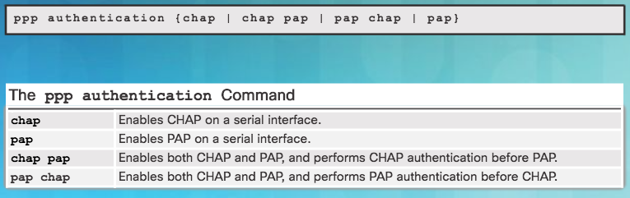
Configure PPP Authentication PPP Authentication Command
To specify the order in which the CHAP or PAP protocols are requested on the interface, use the ppp authentication interface configuration command. Use the no form of the command to disable this authentication.
PAP, CHAP, or both can be enabled. If both methods are enabled, the first method specified is requested during link negotiation. If the peer suggests using the second method or simply refuses the first method, the second method should be tried.
Notes:
2.3 – PPP Implementation
2.3.2 – Configure PPP Authentication
2.3.2.4 – PPP Authentication Command

Slide 50
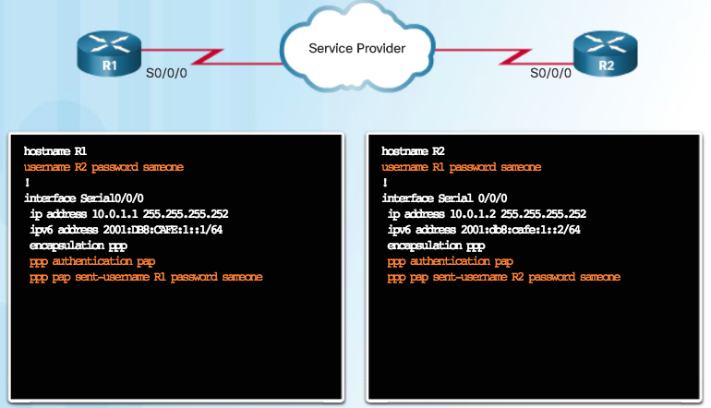
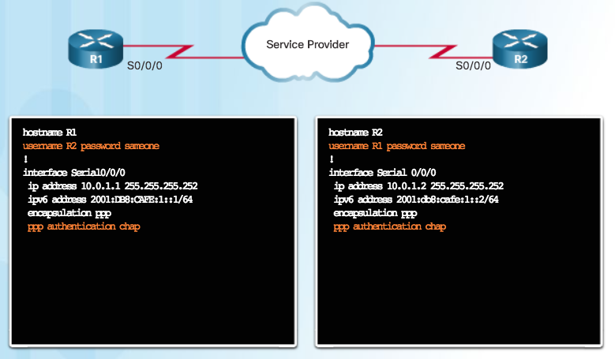
Configure PPP Authentication Configuring PPP with Authentication
CHAP: Hostname on one router must match the username the other router has configured. The passwords must also match. Occurs on link establishment and can be repeated.
PAP Authentication Configuration
CHAP Authentication Configuration
PAP: Hostname on one router must match the username the other router has configured for PPP. The passwords must also match.
Notes:
2.3 – PPP Implementation
2.3.2 – Configure PPP Authentication
2.3.2.5 – Configuring PPP with Authentication

Slide 51
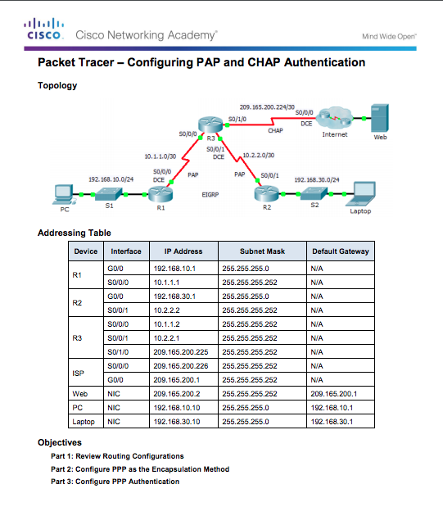
Configure PPP Authentication Packet Tracer – Configuring PAP and CHAP Authentication
Notes:
2.3 – PPP Implementation
2.3.2 – Configure PPP Authentication
2.3.2.6 – Packet Tracer – Configuring PAP and CHAP Authentication

Slide 52
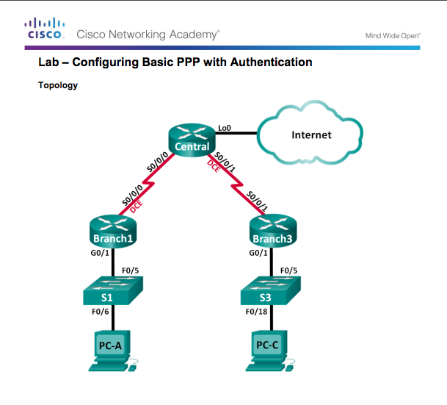
Configure PPP Authentication Lab – Configuring Basic PPP with Authentication
Notes:
2.3 – PPP Implementation
2.3.2 – Configure PPP Authentication
2.3.2.7 – Lab – Configuring Basic PPP with Authentication

Slide 53
2.4 Troubleshoot WAN Connectivity
Notes:
2 - Point-to-Point Connections
2.4 – Troubleshoot WAN Connectivity

Slide 54
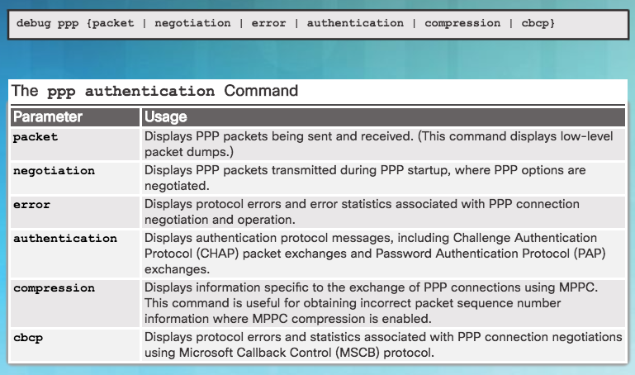
Troubleshoot PPP Troubleshooting PPP Serial Encapsulation
debug ppp Command Parameters
debug command must not be used as a monitoring tool
meant to be used for a short period of time for troubleshooting
can consume a significant amount of resources
Notes:
2.4 – Troubleshoot WAN Connectivity
2.4.1 – Troubleshoot PPP
2.4.1.1 – Troubleshooting PPP Serial Encapsulation

Slide 55
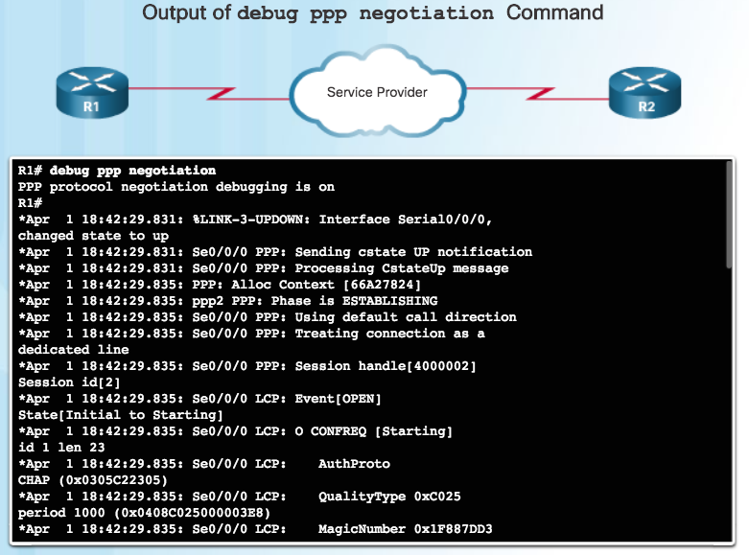
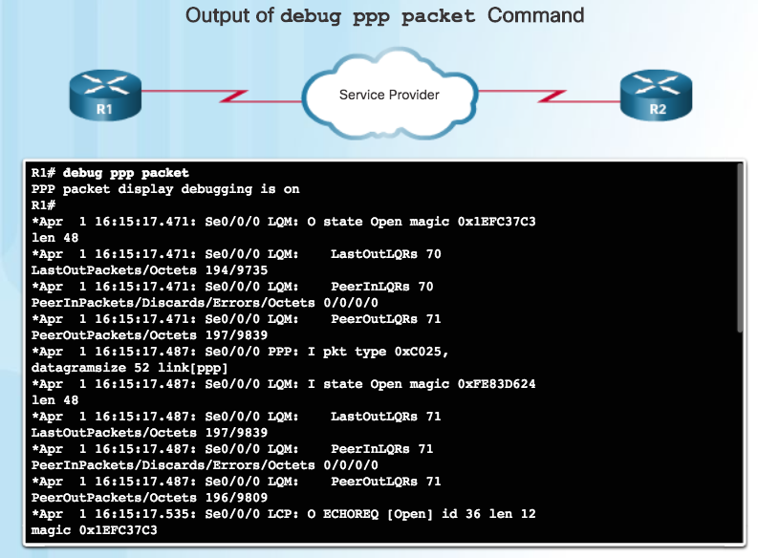
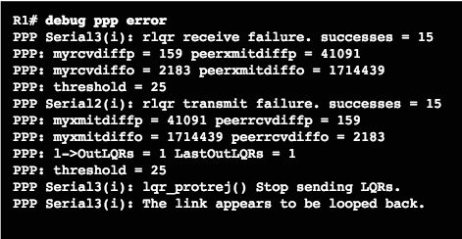
Troubleshoot PPP Debug PPP
Notes:
2.4 – Troubleshoot WAN Connectivity
2.4.1 – Troubleshoot PPP
2.4.1.2 – Debug PPP

Slide 56
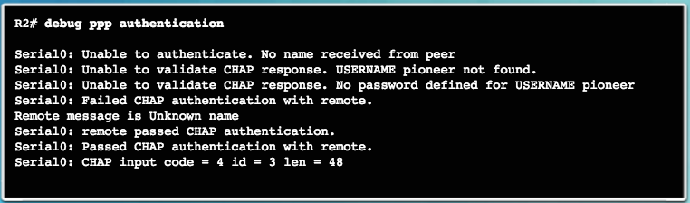
Troubleshoot PPP Troubleshooting a PPP Configuration with Authentication
In the last line, the code 4 means that a failure has occurred. Other code values are as follows:
1 – Challenge 2 – Response 3 – Success 4 - Failure
id - 3 is the ID number per LCP packet format len - 48 is the packet length without the header
Notes:
2.4 – Troubleshoot WAN Connectivity
2.4.1 – Troubleshoot PPP
2.4.1.3 – Troubleshooting a PPP Configuration with Authentication

Slide 57
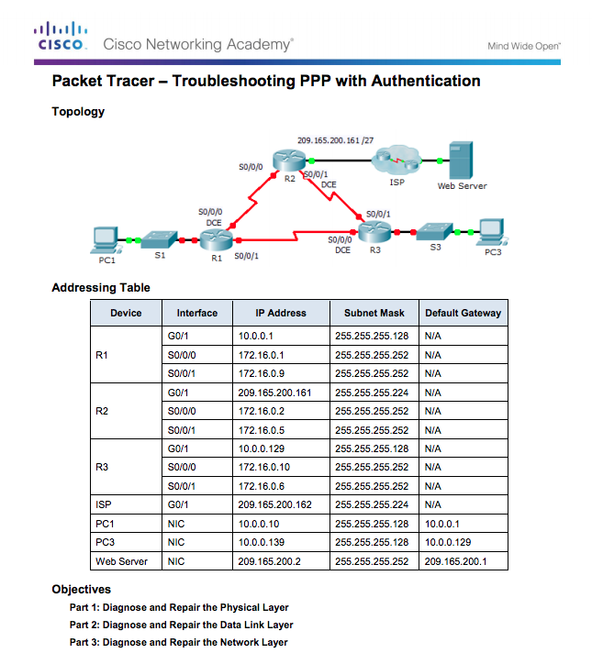
Troubleshoot PPP Packet Tracer - Troubleshooting a PPP Configuration with Authentication
Notes:
2.4 – Troubleshoot WAN Connectivity
2.4.1 – Troubleshoot PPP
2.4.1.4 – Packet Tracer -Troubleshooting a PPP Configuration with Authentication

Slide 58
Troubleshoot PPP Lab - Troubleshooting Basic PPP with Authentication
Notes:
2.4 – Troubleshoot WAN Connectivity
2.4.1 – Troubleshoot PPP
2.4.1.5 – Lab - Troubleshooting Basic PPP with Authentication

Slide 59
2.5 Summary
Notes:
2 – Point-to-Point Connections
2.5 – Summary

Slide 60
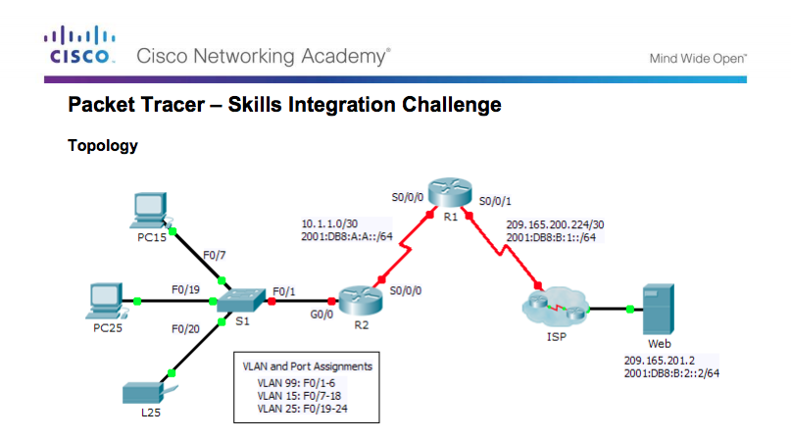
Conclusion Packet Tracer – Skills Integration Challenge
Notes:
2.5 – Summary
2.5.1 – Conclusion
2.5.1.2 – Packet Tracer –Skills Integration Challenge

Slide 61
Conclusion Chapter 2: Point-to-Point Connections
Configure HDLC encapsulation.
Explain how PPP operates across a point-to-point serial link.
Configure PPP encapsulation.
Troubleshoot PPP
Notes:
2.5 – Summary
2.5.1 – Conclusion

Slide 62
Chapter 2 New Terms and Commands
High-Level Data Link Control (HDLC) Point-to-Point Protocol (PPP) serial connection parallel connection Clock skew parallel ports RS-232 serial ports Universal Serial Bus (USB) interfaces digital signal level (DS) synchronous circuits asynchronous circuits Password Authentication Protocol (PAP) Challenge Handshake Authentication Protocol (CHAP) Serial Line Internet Protocol (SLIP) | X.25 Link Access Procedure, Balanced (LAPB) bit-oriented Synchronous Data Link Control (SDLC) Carrier Detect (CD) signal Keepalives trunk lines Link Control Protocol (LCP) Network Control Protocols (NCPs) link quality management (LQM) IP Control Protocol (IPCP) IPv6 uses IPv6 Control Protocol (IPv6CP)
Notes:
New Terms and Commands

Slide 63
Chapter 2 New Terms and Commands (Cont.)
Link-establishment frames Link-maintenance frames Link-termination frames PPP Callback Multilink PPP Message Digest 5 (MD5)
Notes:
New Terms and Commands

